Slide 1

The Method
Java's documentation states that:
A method declares executable code that can be invoked, passing a fixed number of values as arguments.
COMPLETE JAVA MASTERCLASS
Methods Recap

Slide 2
Is the method a statement or an expression?
Like some of the abbreviated operators we learned about, a method can be a statement or an expression in some instances.
Any method can be executed as a statement.
A method that returns a value can be used as an expression, or as part of any expression.
COMPLETE JAVA MASTERCLASS
Methods Recap

Slide 3
What are functions and procedures?
Some programming languages will call a method that returns a value, a function, and a method that doesn't return a value, a procedure.
You'll often hear function and method used interchangeably in Java.
The term procedure is somewhat less common, when applied to Java methods, but you may still hear a method with a void return type, called procedure.
COMPLETE JAVA MASTERCLASS
Methods Recap

Slide 4
Declaring the Method
So there are quite a few declarations that need to occur as we create a method.
This consists of:
Declaring Modifiers. These are keywords in Java with special meanings, we've seen public and static as examples, but there are others.
Declaring the return type.
void is a Java keyword meaning no data is returned from a method.
Alternatively, the return type can be any primitive data type or class.
If a return type is defined, the code block must use at least one return statement, returning a value, of the declared type or comparable type.
COMPLETE JAVA MASTERCLASS
Methods Recap

Slide 5
Declaring the Method
Declaring the method name. Lower camel case is recommended for method names.
Declaring the method parameters in parentheses. A method is not required to have parameters, so a set of empty parentheses would be declared in that case.
Declaring the method block with opening and closing curly braces. This is also called the method body.
COMPLETE JAVA MASTERCLASS
Methods Recap

Slide 6
Declaring the Parameters
Parameters are declared as a list of comma-separated specifiers, each of which has a parameter type and a parameter name (or identifier).
Parameter order is important when calling the method.
The calling code must pass arguments to the method, with the same or comparable type, and in the same order, as the declaration.
The calling code must pass the same number of arguments, as the number of parameters declared.
COMPLETE JAVA MASTERCLASS
Methods Recap

Slide 7
Declaring the Return Type
When declaring a return type:
void is a valid return type, and means no data is returned.
Any other return type requires a return statement, in the method code block.
COMPLETE JAVA MASTERCLASS
Methods Recap

Slide 8
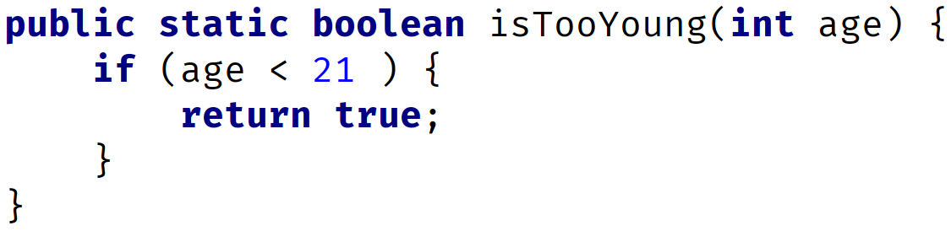
The Return Statement for methods that have a return type
If a method declares a return type, meaning it's not void, then a return type is required at any exit point from the method block.
Consider the method block shown here:
COMPLETE JAVA MASTERCLASS
Methods Recap

Slide 9
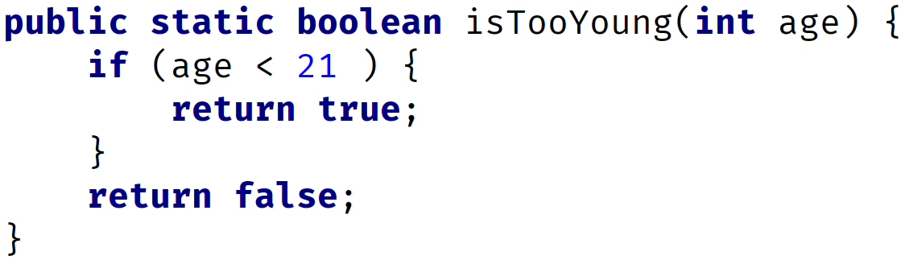
The Return Statement for methods that have a return type
So in the case of using a return statement in nested code blocks in a method, all possible code segments must result in a value being returned.
The following code demonstrates one way to do this:
COMPLETE JAVA MASTERCLASS
Methods Recap

Slide 10
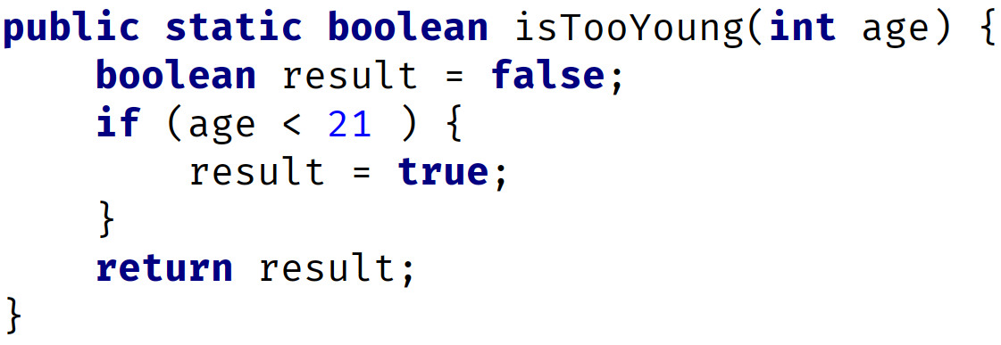
The Return Statement for methods that have a return type
One common practice is to declare a default return value at the start of a method, and only have a single return statement from a method, returning that variable, as shown in this example method:
COMPLETE JAVA MASTERCLASS
Methods Recap

Slide 11
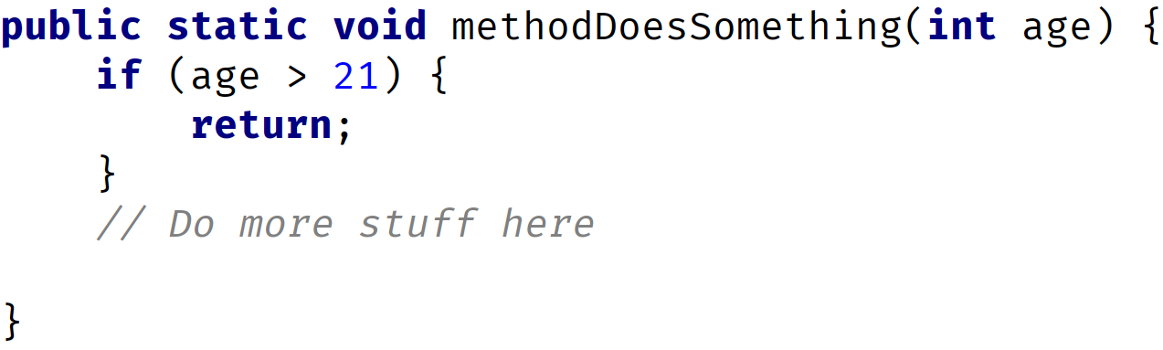
The Return Statement for methods that have void as the return type
The return statement can return with no value from a method, which is declared with a void return type.
In this case, the return statement is optional, but it may be used to terminate execution of the method at some earlier point than the end of the method block, as shown here:
COMPLETE JAVA MASTERCLASS
Methods Recap

Slide 12
The Method Signature
A method is uniquely defined in a class by its name, and the number and type of parameters that are declared for it.
This is called the method signature.
You can have multiple methods with the same method name, as long as the method signature (meaning the parameters declared) are different.
This will become important later in this section, when we cover overloaded methods.
COMPLETE JAVA MASTERCLASS
Methods Recap

Slide 13
Default values for parameters
In many languages, methods can be defined with default values, and you can omit passing values for these when calling the method.
But Java doesn't support default values for parameters.
There are work-arounds for this limitation, and we'll be reviewing those at a later date.
But it's important to state again, in Java, the number of arguments you pass, and their type, must match the parameters in the method declaration exactly.
COMPLETE JAVA MASTERCLASS
Methods Recap

Slide 14
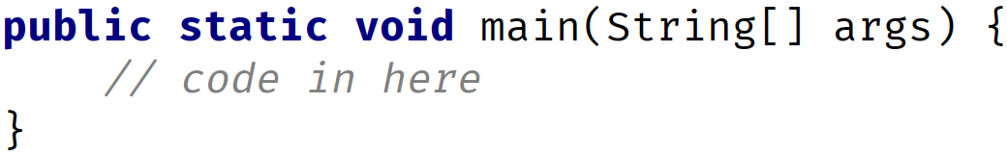
Revisiting the main method
Now, that we're armed with knowledge about methods, we can revisit the main method, and examine it again.
The main method is special in Java, because Java's virtual machine (JVM) looks for the method, with this particular signature, and uses it as the entry point for execution of code.
COMPLETE JAVA MASTERCLASS
Methods Recap

Slide 15
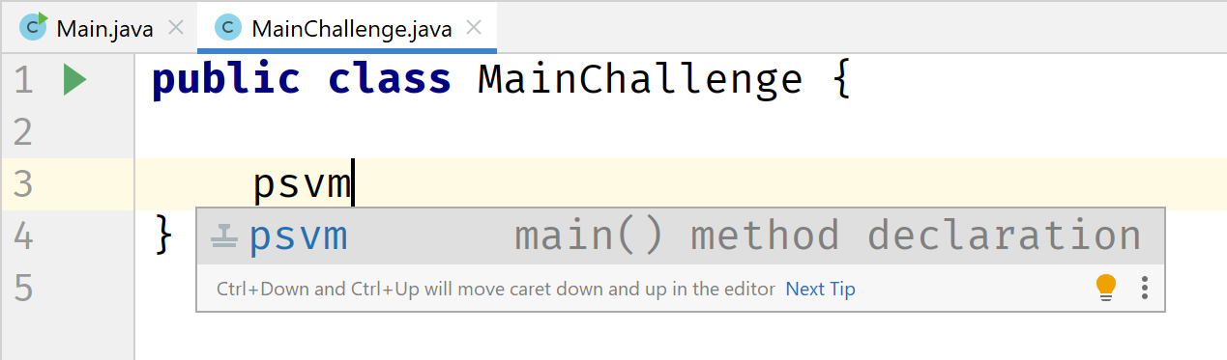
IntelliJ hint
Finally, in IntelliJ, if you type psvm and hit enter, IntelliJ will insert the main method signature as we show here.
The only reason to memorize this signature, would be if you were taking a certification exam.
COMPLETE JAVA MASTERCLASS
Methods Recap

Slide 16
IntelliJ hint
Finally, in IntelliJ, if you type psvm and hit enter, IntelliJ will insert the main method signature as we show here.
The only reason to memorize this signature, would be if you were taking a certification exam.
COMPLETE JAVA MASTERCLASS
Methods Recap

